Slide 1
Usability Testing
From: http://www.usability.gov/methods/test_refine/learnusa/index.html
http://www.youtube.com/watch?v=kAG39jKi0l I

Slide 2
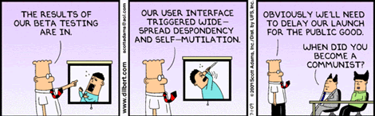
Usability Testing
Testing it with representative users
  users will try to complete typical tasks while observers watch, listen and take notes.
Goal is to identify any usability problems
  collect quantitative data on participants' performance (e.g., time on task, error rates)
  determine participant's satisfaction with the product.
From: http://www.90percentofeverything.com/2009/07/24/more-dilbert-on-user-experience/

Slide 3
When to Test
You should test early and test often. Usability testing lets the design and development teams identify problems before they get coded (i.e., "set in concrete”). The earlier those problems are found and fixed, the less expensive the fixes are.
Tests main flow on paper prototypes

Slide 4
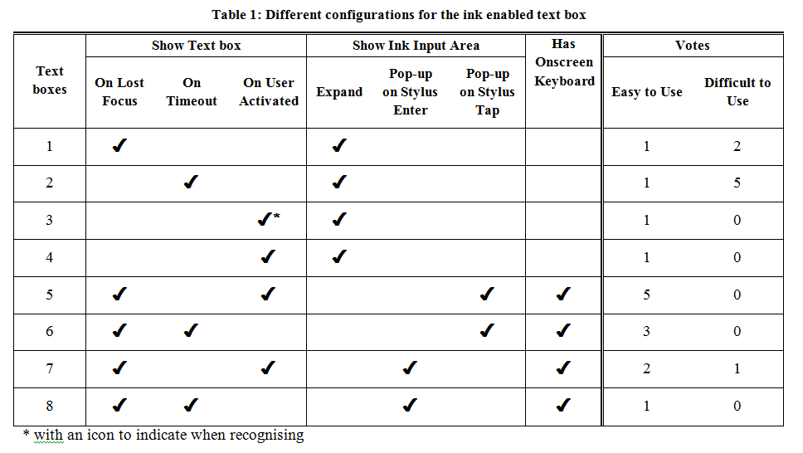
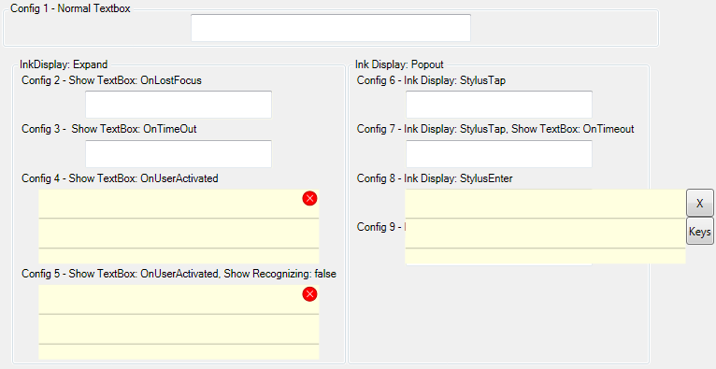
Test little bits
A stylus friendly edit control
Seneviratne, N. and B. Plimmer. Improving Stylus Interaction for eMedical Forms. in OZCHI 2010. 2010. Brisbane: ACM: p. 280-287.

Slide 5
How to test
Know what your goal is
  Navigation
  Specific task
  Specific control
Observe
Record (Morae)
  Co-located
  Remote

Slide 6
What You Learn
Complete routine tasks successfully
  how long it takes to do that.
How satisfied participants are with your interface.
Identify changes required to improve user performance.
Match the performance to see if it meets your usability objectives.

Slide 7
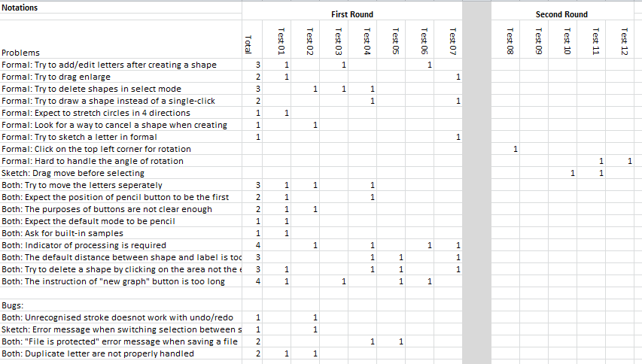
Two iteration evaluation
Big problems mask little ones

Slide 8
Making Use of What You Learn
Someone designed what you are testing
  They may be defensive / offended that their design isn’t already perfect.
  Usability testing is not just a milestone to be checked off on the project schedule. The team must consider the findings, set priorities, and change the prototype or site based on what happened in the usability test.
Find the Best Solution
  Most projects, including designing or revising computer interaction, have to deal with constraints of time, budget, and resources. Balancing all those is one of the major challenges of most projects.

Slide 9
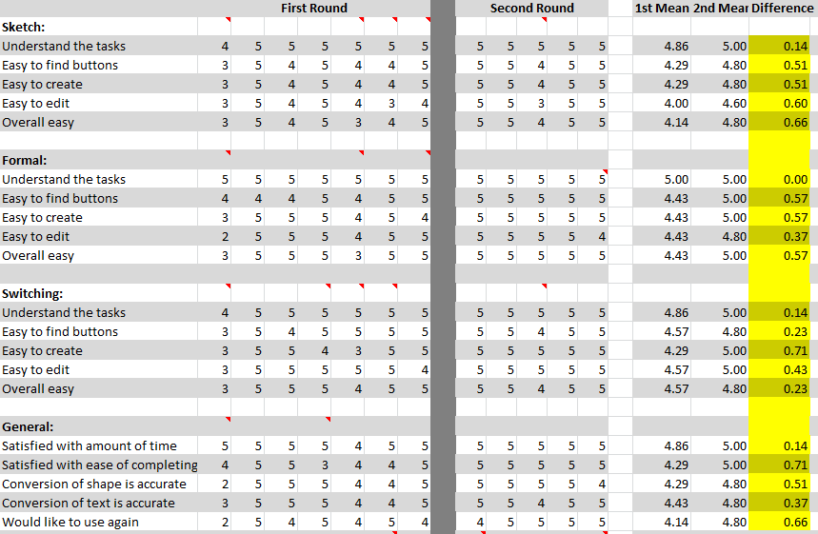
Improved User Satisfaction!

Slide 10
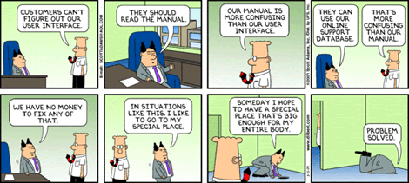
Tips
Testing the Site NOT the Users
From:.http://www.90percentofeverything.com/2009/05/26/dilbert-on-user-experience/

Slide 11
Test Planning
A good plan is absolutely essential for a good test and defendable results.

Slide 12
Results
It is often difficult to sell your results
Numbers are convincing
Video of puzzled users is very compelling

